Slide 1
StreamList Movie Management App
INT499 Capstone
Joe Engbert Eric Dillon

Slide 2
SUMMARY
Project Members
Eric Dillon
Joe Engbert
Content
Project Gantt Chart
User Interface Wireframe
Development Planning
Notes:
This presentation explains the design planning for the StreamList application. The goal of this project is to develop a web-based application that allows users to organize and manage movie watchlists within the EZTechMovie streaming platform. The design work includes a project Gantt chart that outlines development tasks and timelines, along with wireframes that illustrate the structure of the user interface.
The project design is based on the functional and non-functional requirements outlined in the Software Requirements Specification, which defines the system features such as movie list management, search functionality, subscription management, and payment handling.

Slide 3
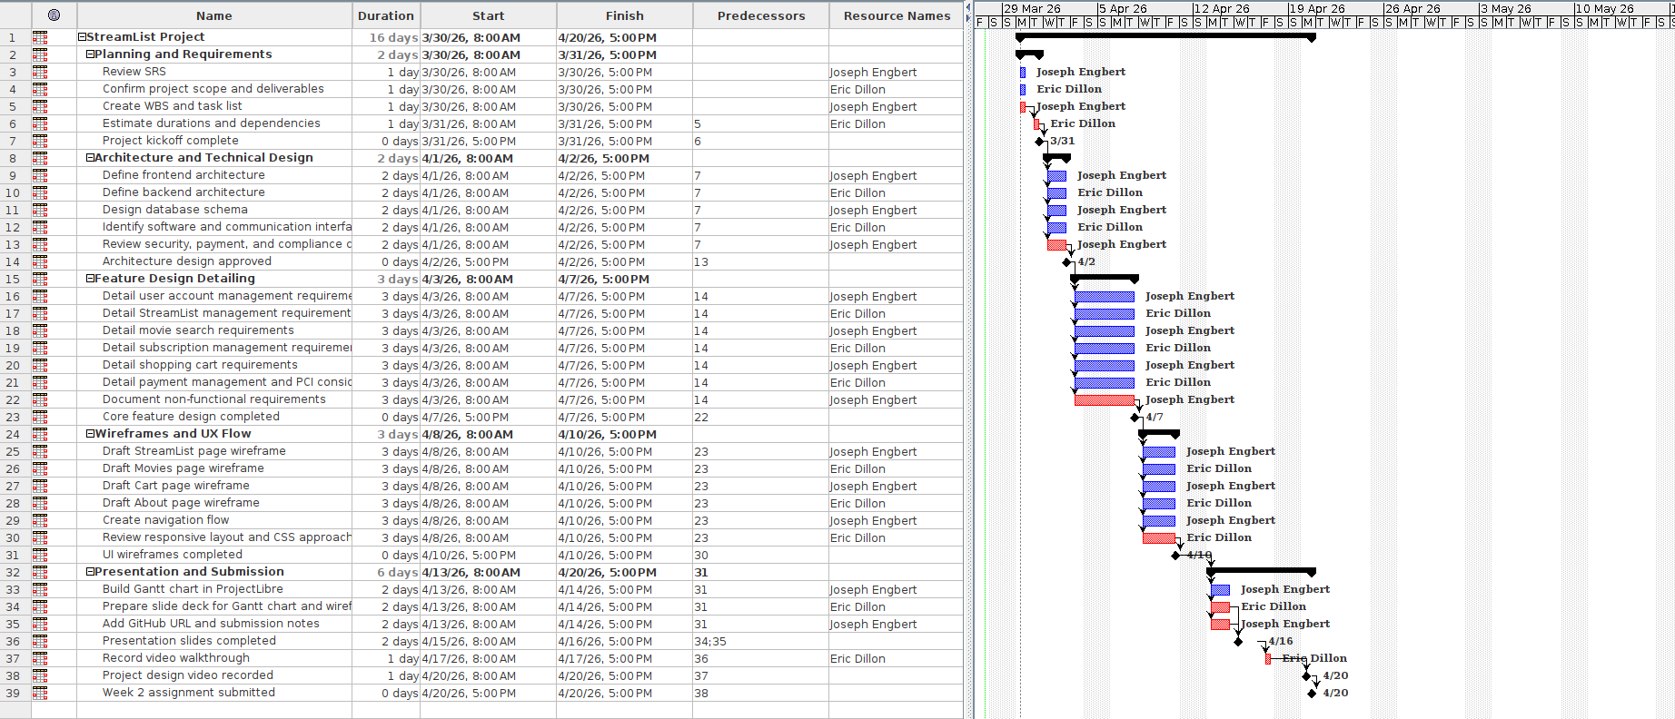
Gantt Chart (Project Planning)
Tasks derived from SRS functional requirements
Sequential and dependent task structure
Parallel development where possible
Timeline from project start to April 20 completion
Milestones for major deliverables
Notes:
The Gantt chart for the StreamList project was created using ProjectLibre to plan the development schedule. Each task in the chart was derived from the functional requirements defined in the Software Requirements Specification, including user account management, movie search functionality, StreamList list management, subscription management, and payment processing.
The tasks are arranged in the order they must be completed. Foundational tasks such as project setup, application structure, and routing are completed first. Once the base application framework is established, development tasks such as UI components, movie search features, and shopping cart functionality can be developed concurrently.
Each task includes a time estimate to provide a realistic timeline for development. Milestones are also included to represent major deliverables such as completion of the application structure, feature implementation, testing, and final project delivery.

Slide 4
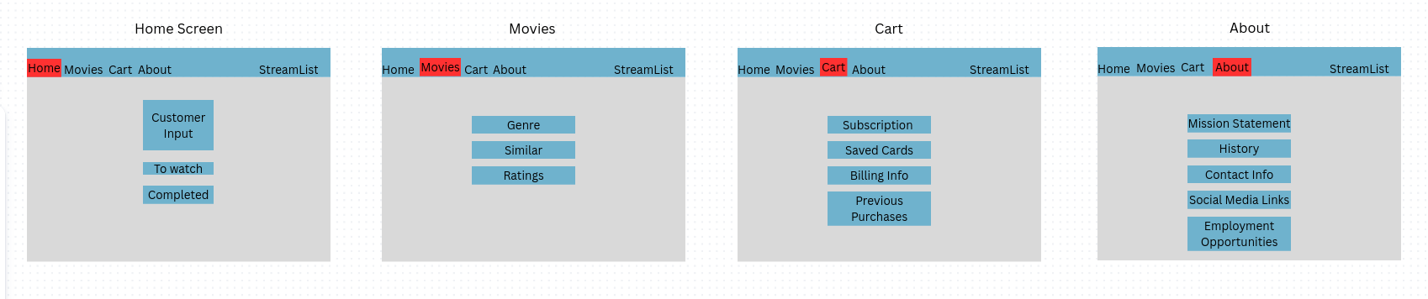
Wireframe Design
Navigation Pages
StreamList (Home)
Movies
Cart
About
User Interface Layout
Top navigation bar
Feature buttons within each page
Simple interaction flow
Component-based structure for React
Notes:
The wireframe illustrates the structure of the StreamList user interface. The purpose of the wireframe is to provide a skeletal layout of the application without focusing on design details such as colors or styling.
The top navigation menu allows users to move between the four primary sections of the application: the StreamList homepage, the Movies page, the Cart page, and the About page.
Each page contains buttons representing the main functional elements of the application. For example, the homepage allows users to enter movie titles and manage lists such as movies to watch or movies already completed. The Movies page will allow users to browse films by genre, find similar movies, and view ratings. The Cart page supports subscription management and billing information, while the About page contains company information and contact details.
The wireframe reflects the component-based structure used in React, where each page will be implemented as an individual component connected through React Router navigation.

Slide 5
Development approach
Technical Stack
React frontend
React Router navigation
Node.js backend
Secure payment processing
Development Strategy
Component-based architecture
Incremental feature development
Testing and deployment milestones
Notes:
The StreamList application will be developed using a modern web application architecture. The user interface will be built using the React framework, which allows the application to be structured as reusable components. Navigation between pages will be handled through React Router.
The backend services will be implemented using Node.js, and a database will be used to store user accounts, movie lists, and transaction information. Payment processing will follow secure industry standards to protect user data.
The project will follow an incremental development approach where features are implemented and tested step by step. This approach allows for better validation of functionality and ensures that the final system meets the requirements defined in the Software Requirements Specification.

